Slide 1



Keystone to the Kingdom
Reconstructing keys based on keymarks/coremarks and other BEST SFIC tricks

Slide 2

Welcome to Anthology
This will be a hands-on version of a 2019 Defcon talk on physical security
Participation isn’t required, but 1st place does receive a prize
More challenges will open after this presentation
Course Materials : http://phy.Ant.red
CTF http://pctf.Ant.red

Slide 3
Agenda
Whoami
Cryo
Pentester (not a locksmith)
Hobbyist
What are SFICs?
Where are they commonly found?
Why do I care about keymarks?
Can we get the keys to the kingdom?
Notes:
I am not a professor

Slide 4
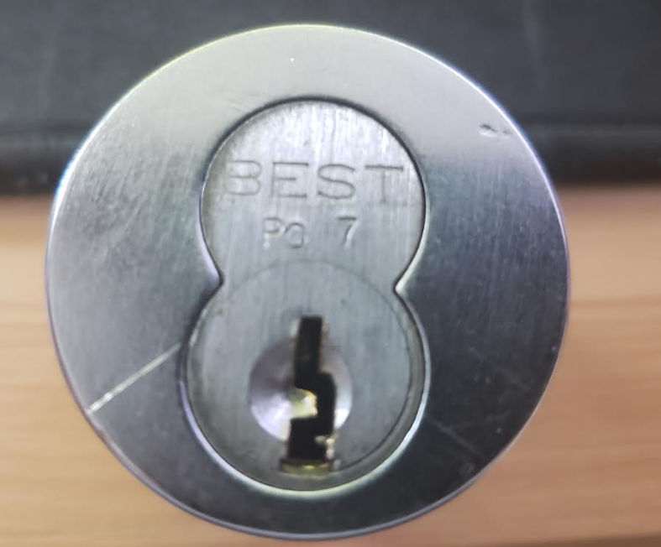
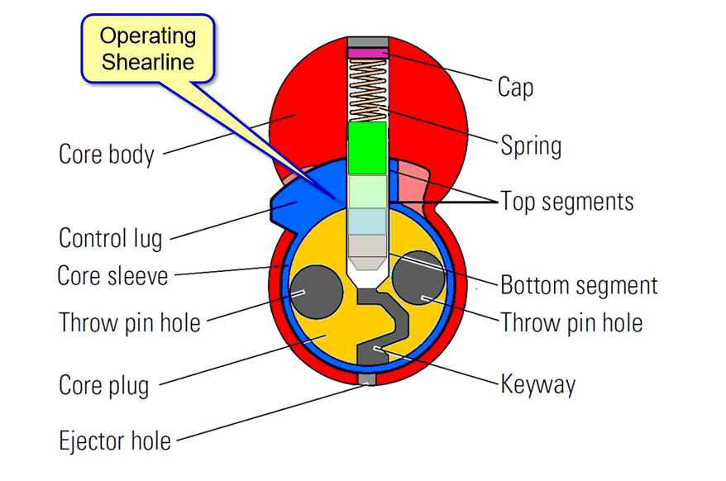
Small Format Interchangeable Core
Commonly found in Hotels, Schools, Office buildings, etc..
Masterkey systems
Removable with a control key
Can be unlocked with an operating key

Slide 5
Video of BEST SFICS
Notes:
Video of holding up and showing the parts and pieces of a best SFIC

Slide 6
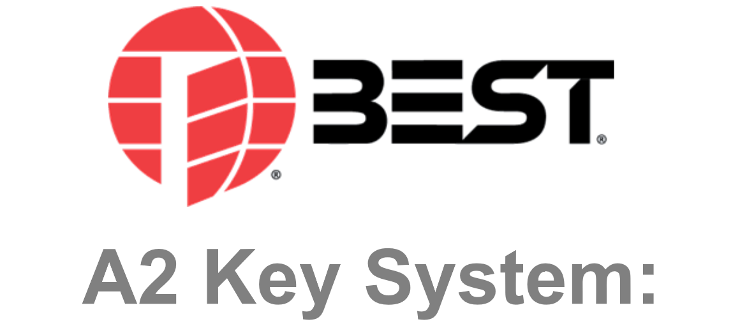
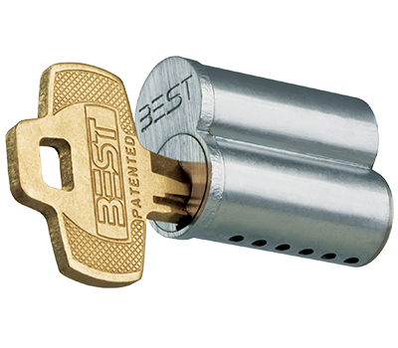
BEST SFIC Keying Systems
A2 vs A3 vs A4 – 7 Pin
A2 = 16,384
A2 is the most common

Slide 7
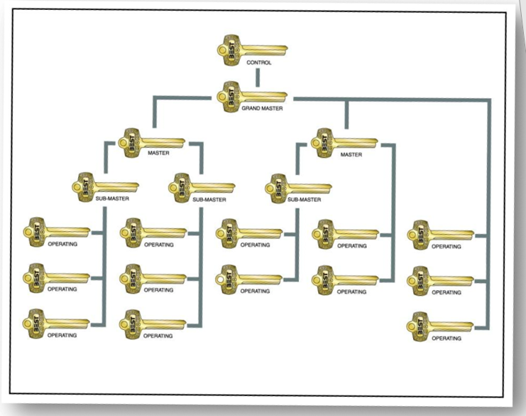
High value keys
CT – Control
GM – Grand master (operates all locks)
MA
MB
MC
MD
AA
AA1
AA2
BB
BB1
SM = Submaster

Slide 8
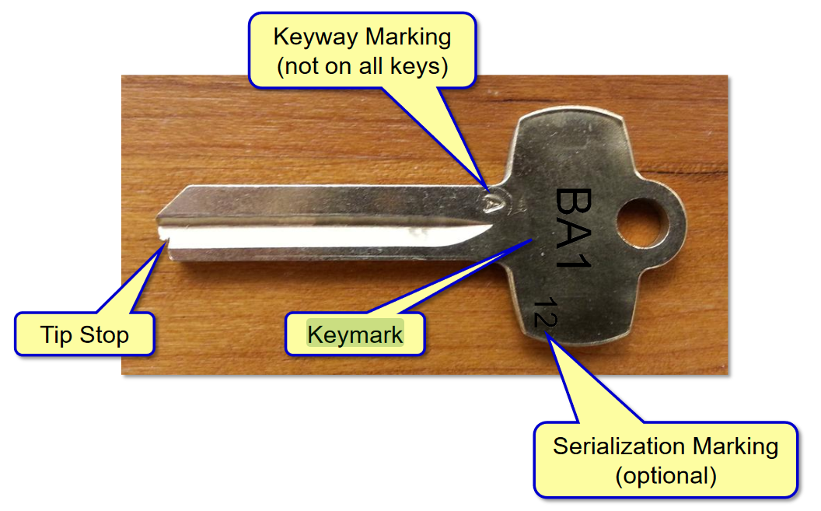
BEST Keys

Slide 9
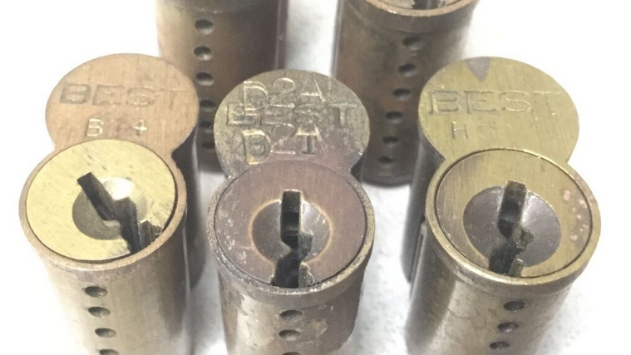
BEST Cores

Slide 10
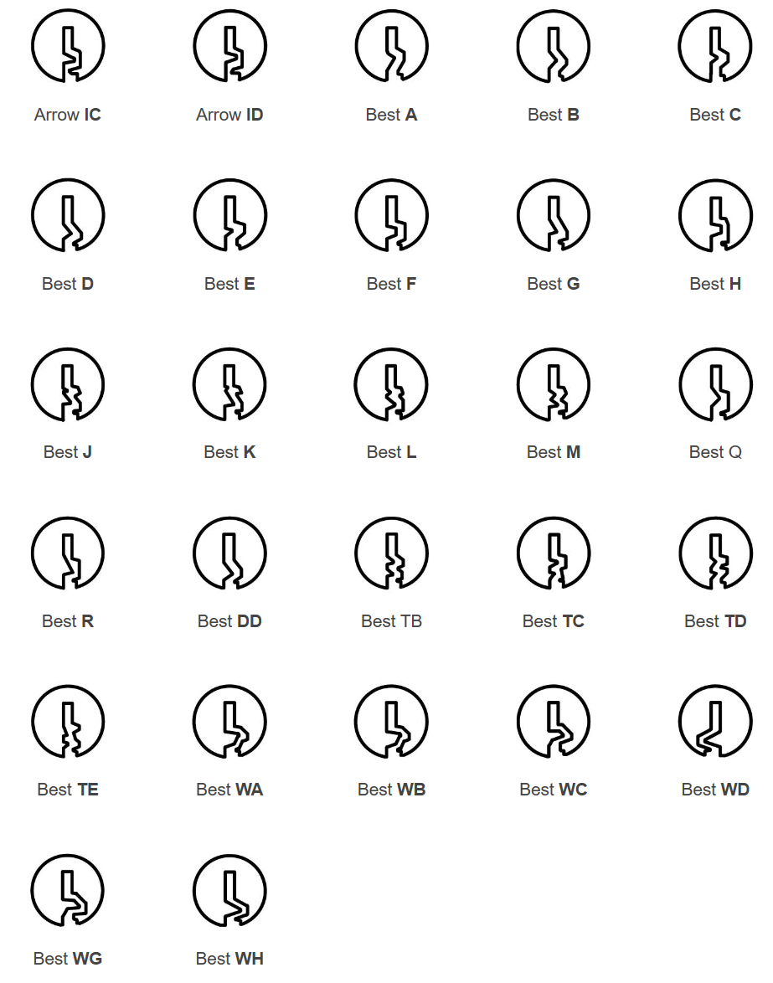
BEST Keyways

Slide 11
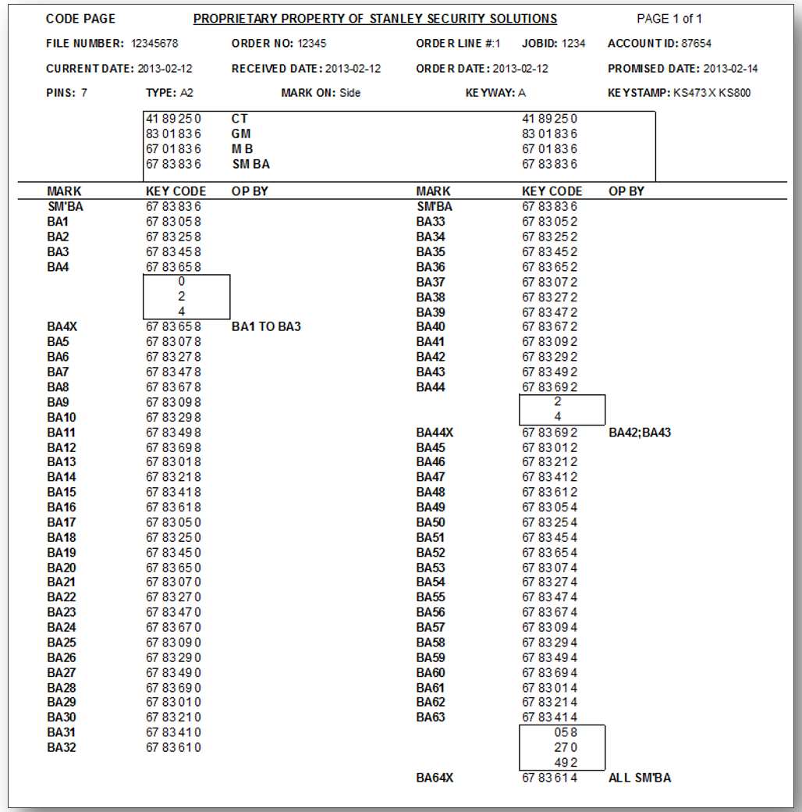
Lateral Movement

Slide 12
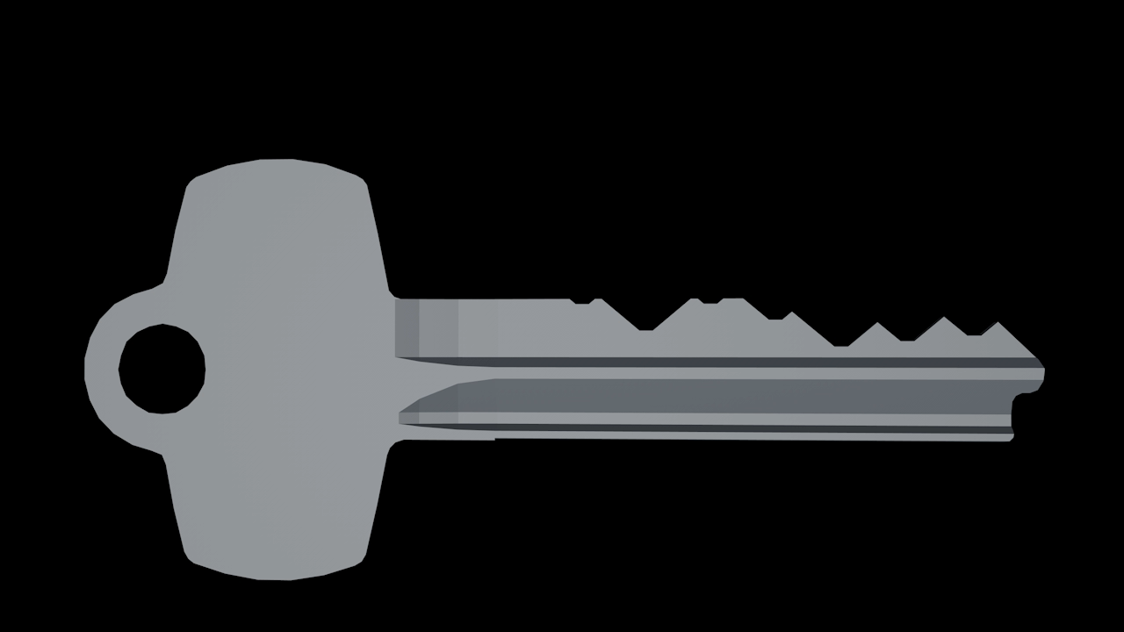

Slide 13

Striking out?

Slide 14
Reconstructing Keys
Code pages link keymarks to keycodes that can be used to cut new keys to code
Includes
Keyway
Coremark location
System Type
Number of Pins
Keystamp (prohibited for redistribution)

Slide 15
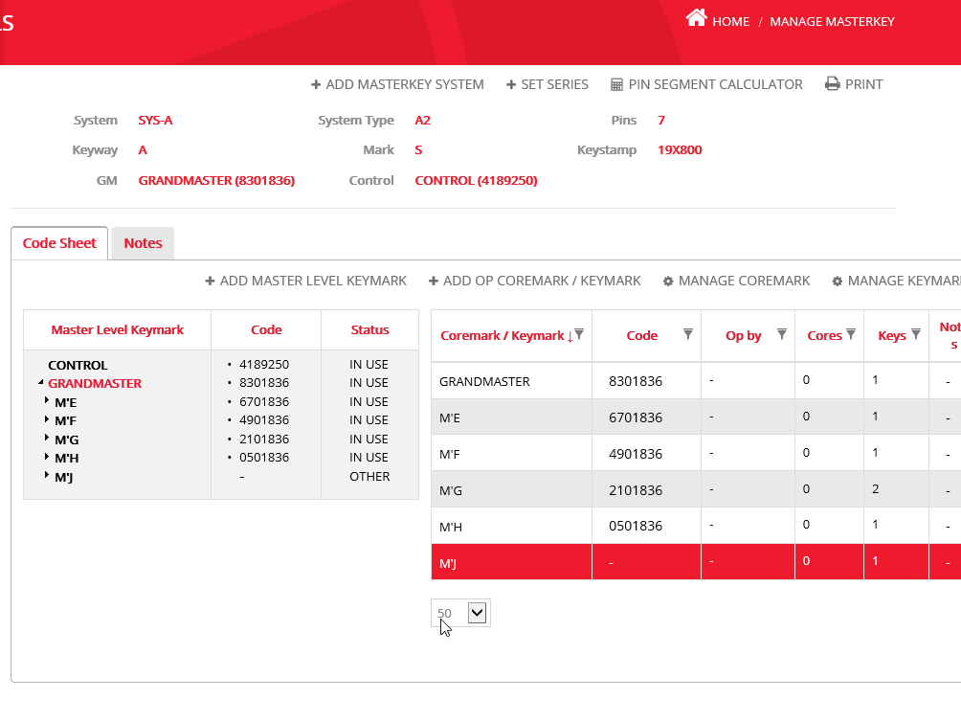
Keystone Web
AD integrated locksmithing software
Description: “Keystone Web helps the user manage keys and core records for multiple personnel throughout various locations. This product allows importing and appending data, mass deletes for employees, keys and door key data, performance improvements in searches and finders, and an activity log that tracks user transactions. ”

Slide 16
Login: MTStudent
Pass: 5Weshouldprocuremorecowbell!
Available at http://ksw.ant.red

Slide 17
Walkthrough CTF
Notes:
Video of holding up and showing the parts and pieces of a best SFIC

Slide 18
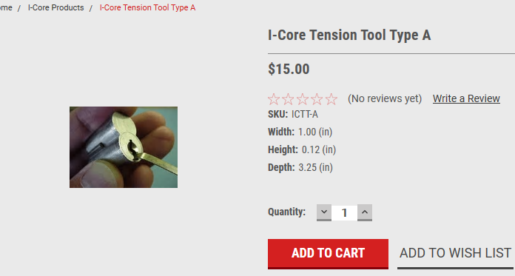
Picking BEST SFICs
Not my favorite things to pick.
Control Sleeve TORQUE tool.
Lots of tension lots of pressure.

Slide 19
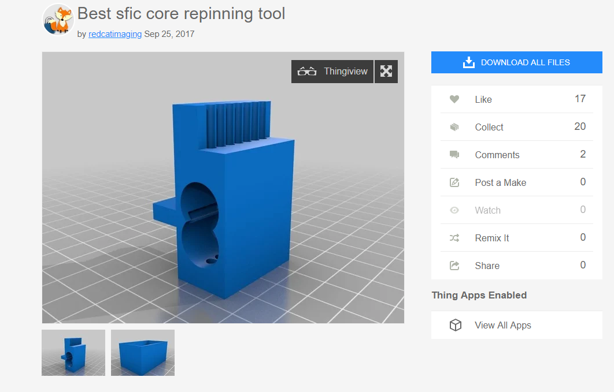
Removing SFIC pins
Available on thingiverse
Very handy for removing SFICs
Retail metal versions are >$100

Slide 20
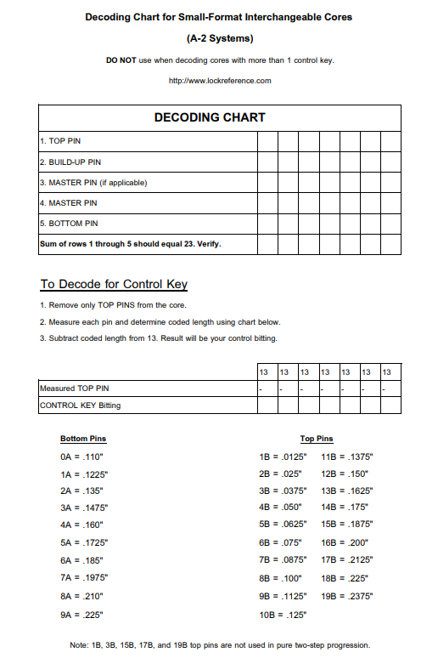
Using a decoding chart
Remove the top pin from the core and subtract it from 13 to get the control key bitting
These are available for download:
https://tinyurl.com/sficchart

Slide 21

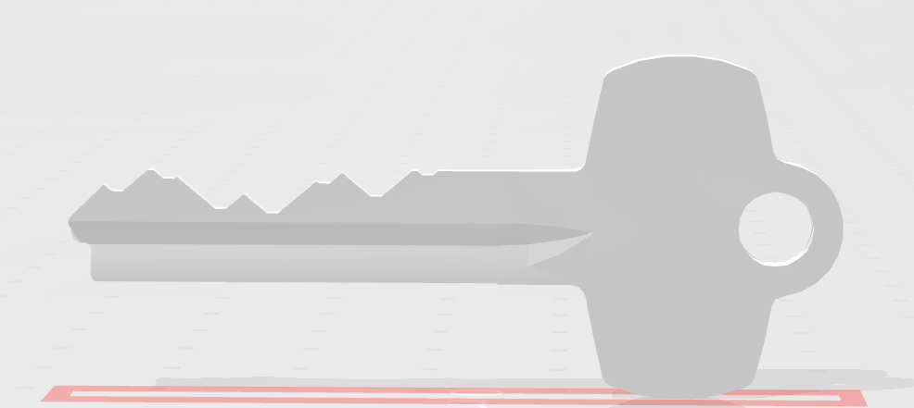
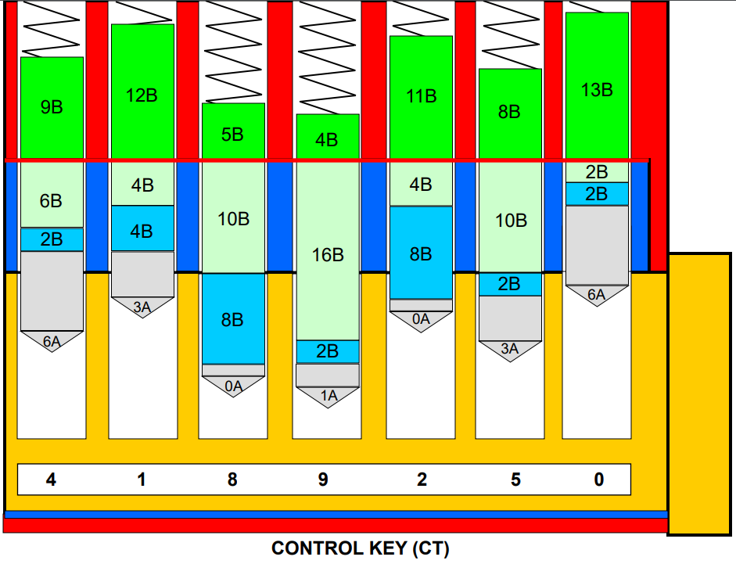
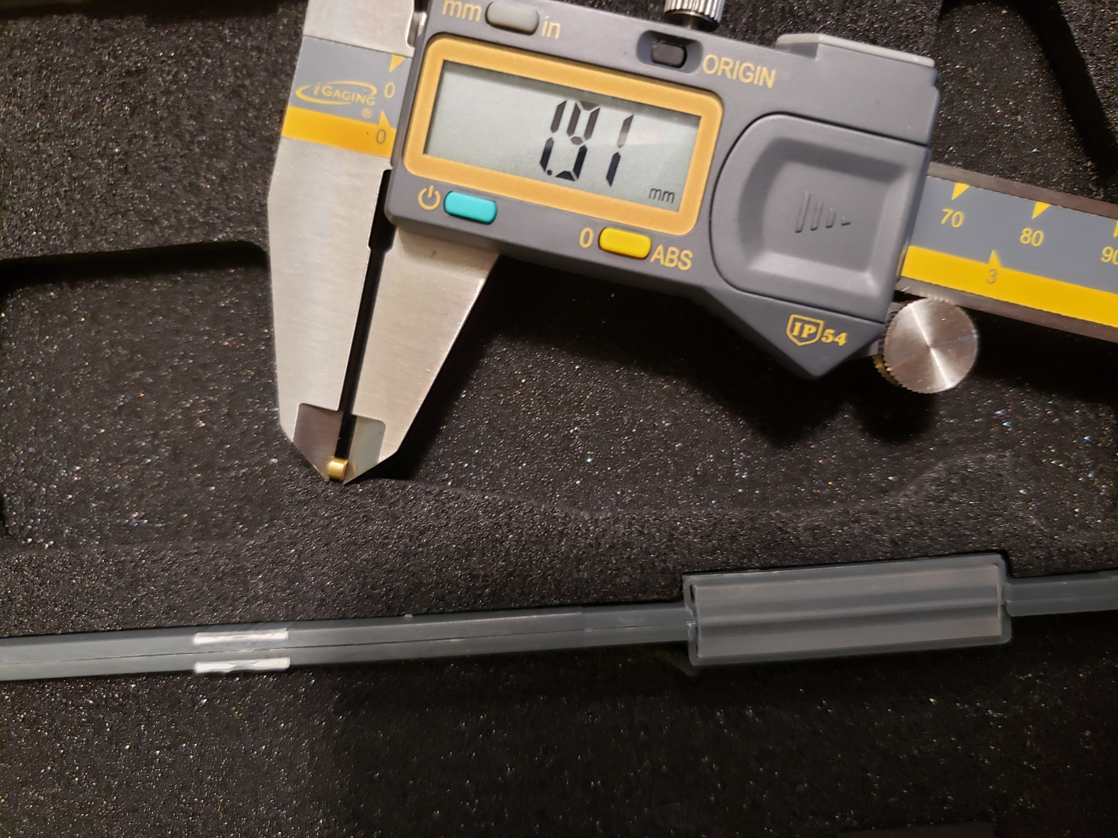
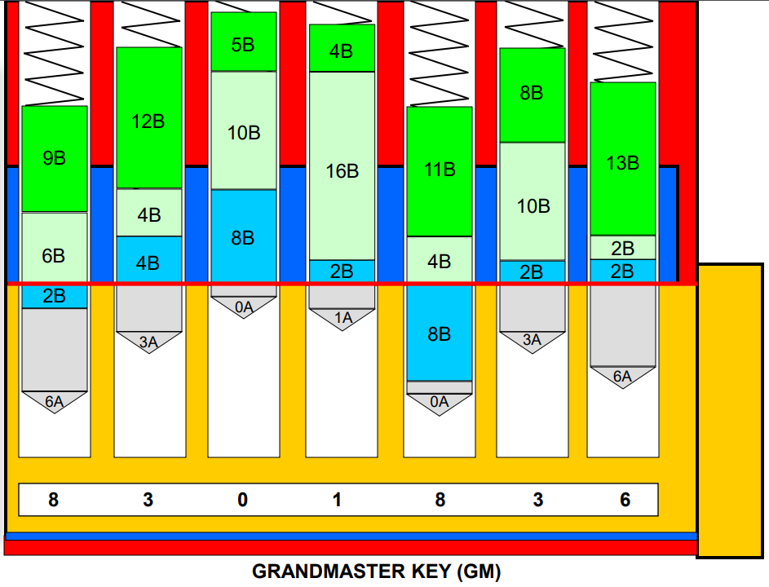
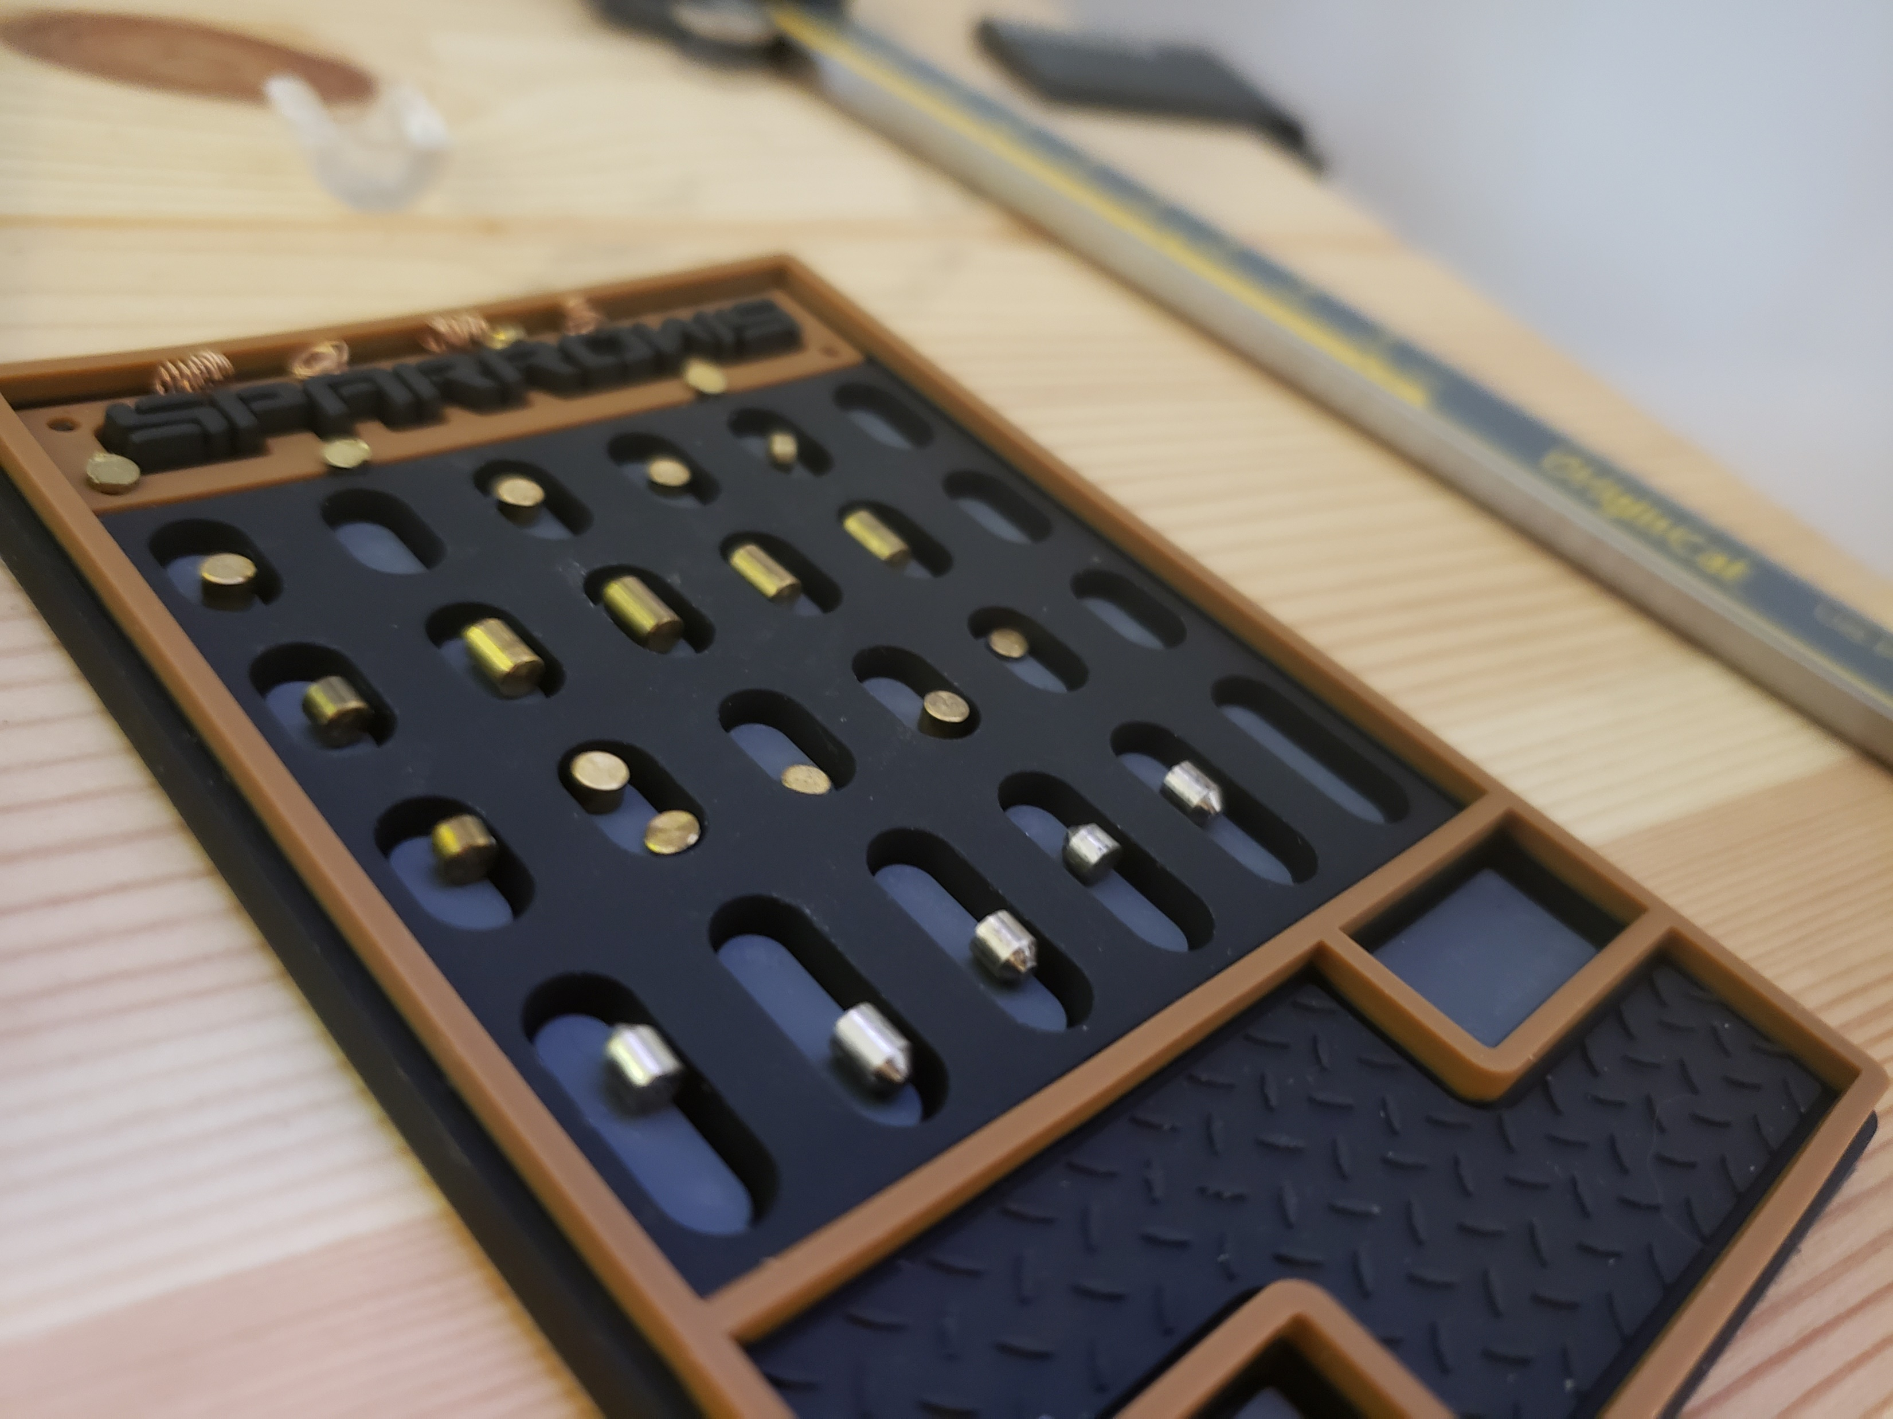
More on decoding
Control key length vs Master key length
Calipers are fairly useful for this
The majority of keys will be somewhere between the Control (CT) key and the GrandMaster (GM) key

Slide 22
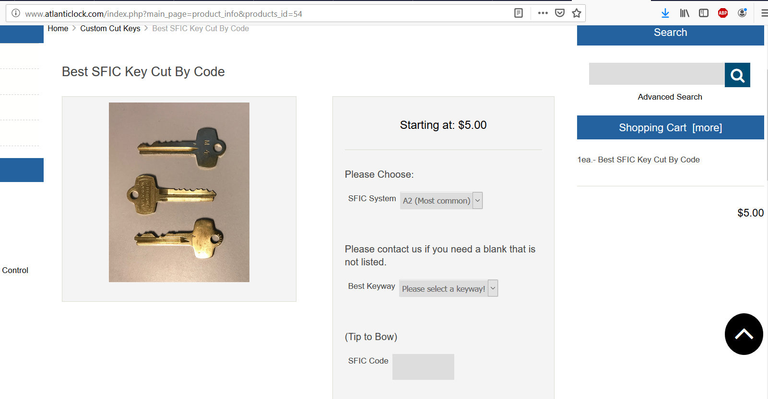
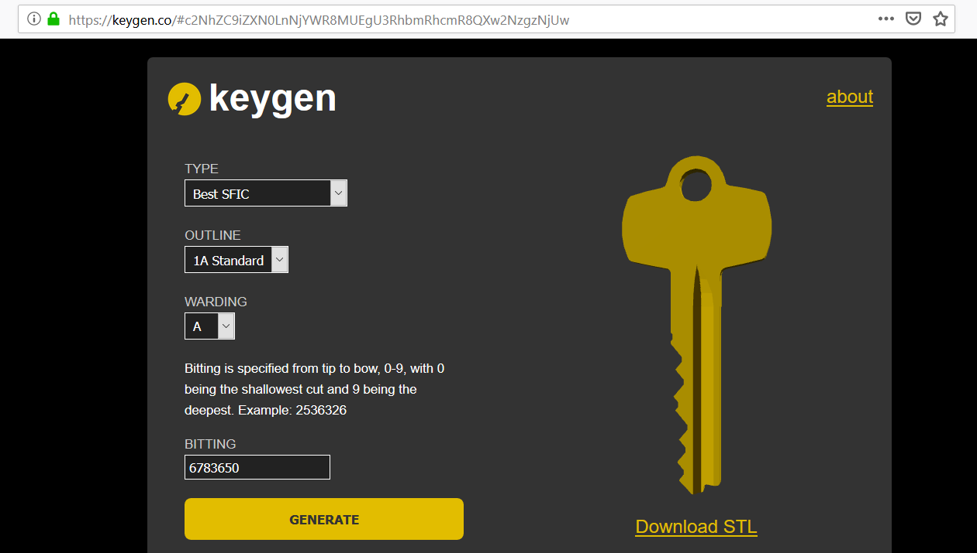
Creating keys
3D printing
Key cutting machines
Online code cutting services
What’s a “do not duplicate” key going to cost you?
How about some blanks you can manufacture yourself?

Slide 23
Continued Education
https://github.com/icryo/Anthology
Keystone Web User Guide
Control Sleeve Manipulation
YouTube
Gutting SFICs
LPL – Picking SFICs
LPL – Destructive SFIC Methods
DO – Physical Entry
DO – Abusing Elevators
DO – TSA Keys
Notes:
Video of holding up and showing the parts and pieces of a best SFIC

Slide 24
Thanks!
Questions?
Slides available at http://phy.ant.red
Twitter @icryo

